Slide 1
Modeling Air Density in Tensorflow Probability

Slide 2



Background
K models the affect of air density (p) on a batted baseball using this equation[1]:
Where A is the area and m is the mass of the ball.
We are interested in simulating values for p [2]:

Slide 3
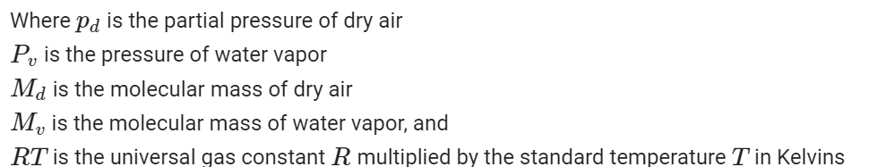



(measurement unit of all these variables is pascals (PA) except temperature which is in C)

Slide 4
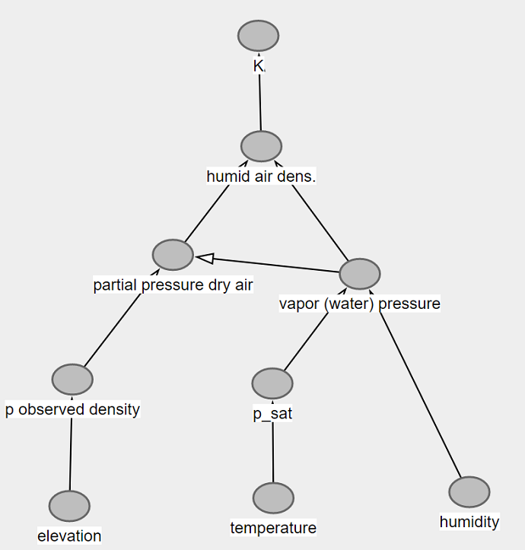




Slide 5
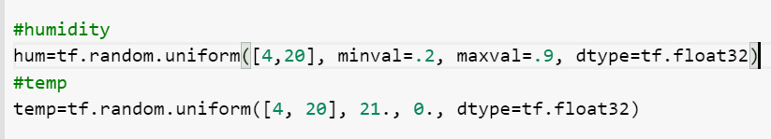
Elevation=184 meters
We want to simulate p with local effects for the park on campus
We need some local humidity and temperature data
We can simulate this with a few assumptions about the range of the data:

Slide 6
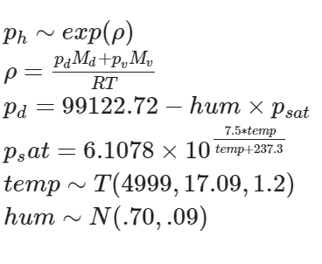
Model
<- this exponential distribution is b/c air density is lower when temperature and humidity are higher
<- This rho is the equation we want to solve
<-this is our partial pressure with the humidity prior
<- same but the saturation pressure w/ temp
<- temp assumes a student T distribution with DF N-1, mean roughly 60 degrees F, sigma=1.2
<- humidity is normally distributed with mean 70%, sigma around 10 %

Slide 7
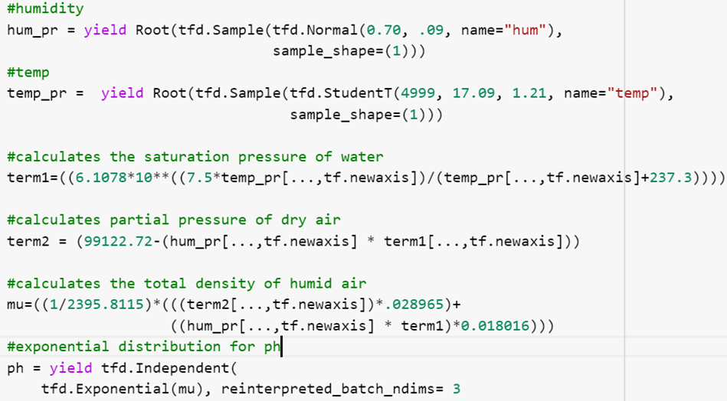
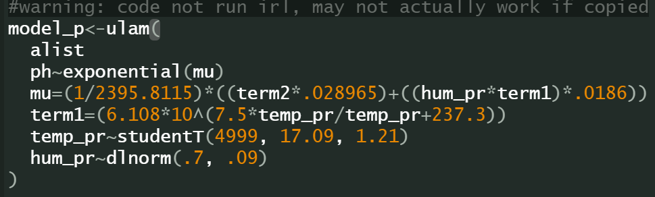




Slide 8
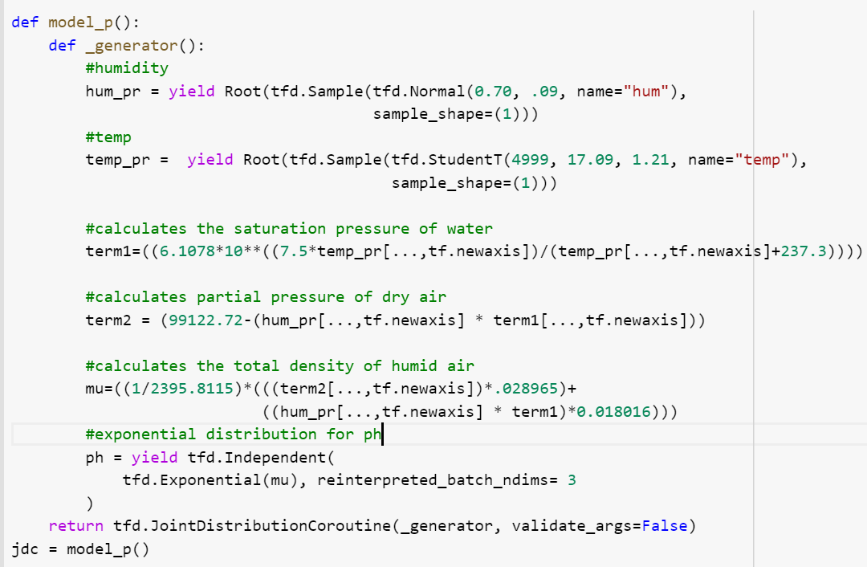

Slide 9
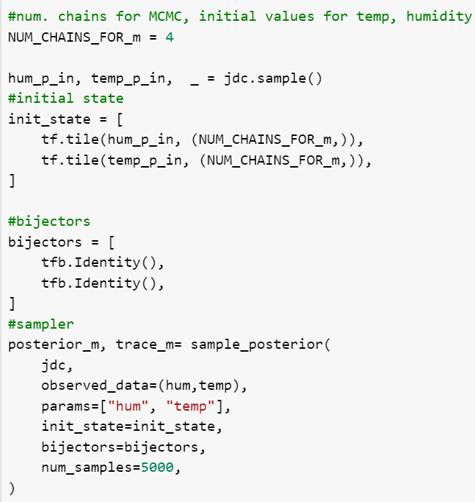
<- #chains
<-initial state/initial values are a sample taken from
the model we defined earlier
(one for hum, one for temp)
<- bijectors
(Basically these are smoothing kernels but not exactly)
<-calls our model definition from earlier
<- the “live” data we simulated
<-number of samples per chain

Slide 10
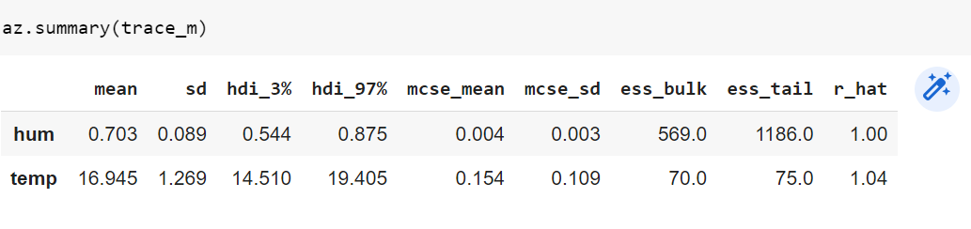
Model Summary

Slide 11

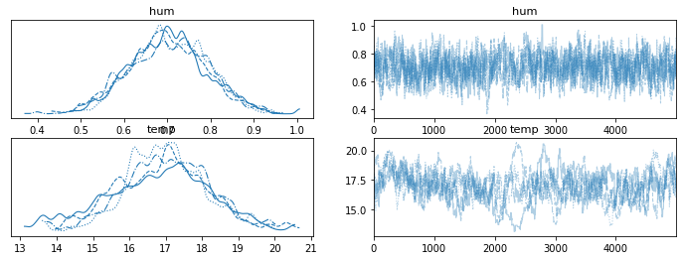
Model Summary

Slide 12
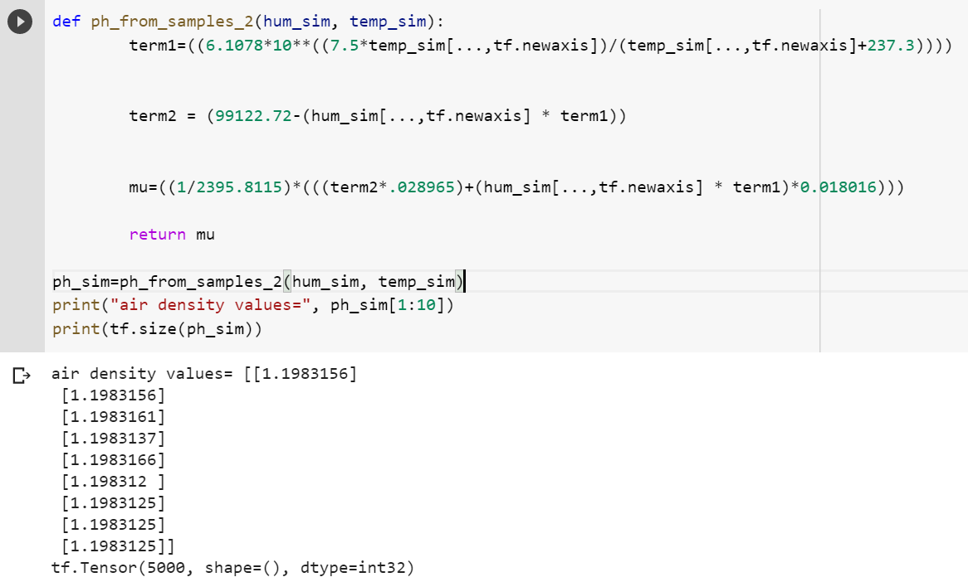
Results

Slide 13
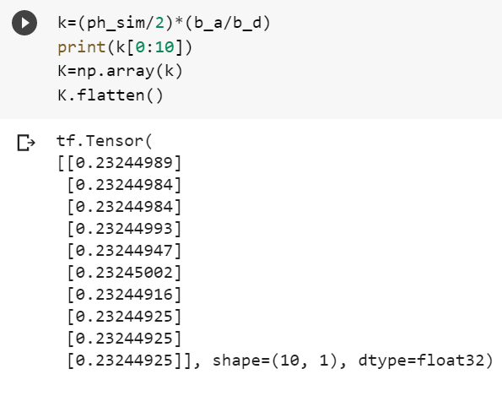
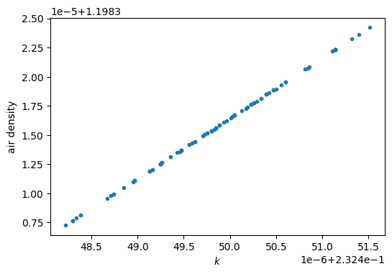
Simulated values for k
Plot of k~air density

Slide 14
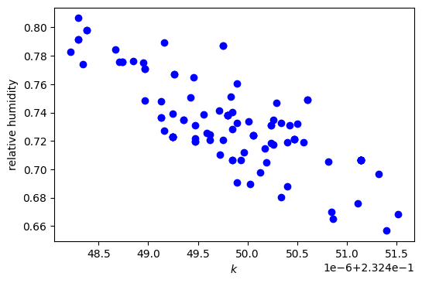
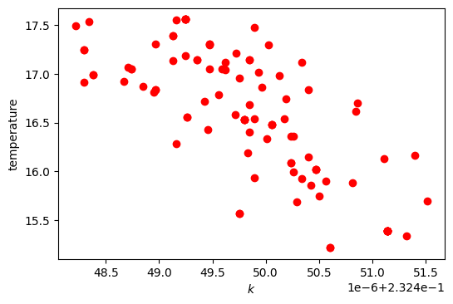
K~relative humidity K~temperature

Slide 15
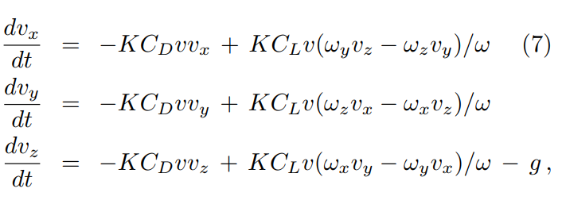
Conclusion
-This model can simulate this air density effect quickly and easily
Final product is a dataset that can be reused in larger modeling tasks
This method is likely also applicable to simulating many different types of parameters in equations

Slide 16

References
[1] Nathan, Alan. Analysis of Baseball Trajectories. 28 Aug. 2017, baseball.physics.illinois.edu/TrajectoryAnalysis.pdf.
[2]“Density of Air.” Wikipedia, 17 June 2019, en.wikipedia.org/wiki/Density_of_air.
[3]“Barometric Formula.” Wikipedia, 10 Mar. 2020, en.wikipedia.org/wiki/Barometric_formula#Density_equations.
Code adapted from https://github.com/ksachdeva/rethinking-tensorflow-probability/tree/master/notebooks
Colab notebook for this project:

